Slide 1


Sherlock Advanced Persistent Threat Detection System Rony Xavier (ID: RX294)

Slide 2
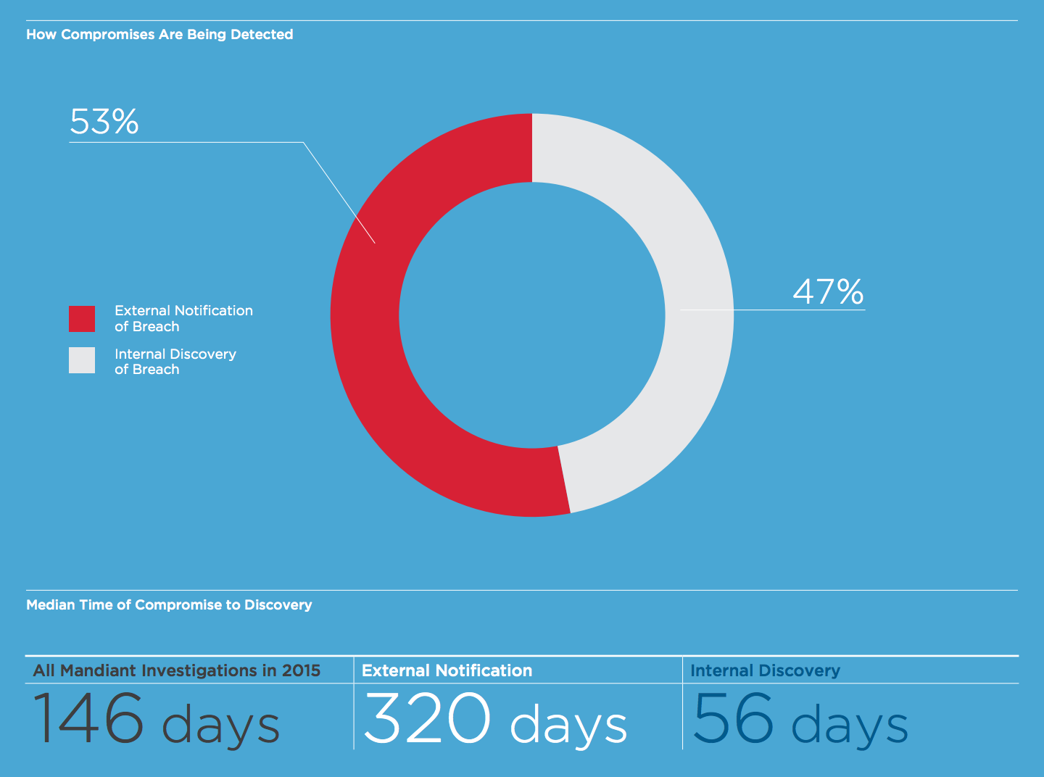
Advanced Persistent Threat (APT)
Advanced Persistent Threat (APT)
Gains access to a network
Stays there undetected for a long period of time.
Intention of an APT attack is to steal data
Not to cause damage
Not easily detected by traditional cyber security measures

Slide 3
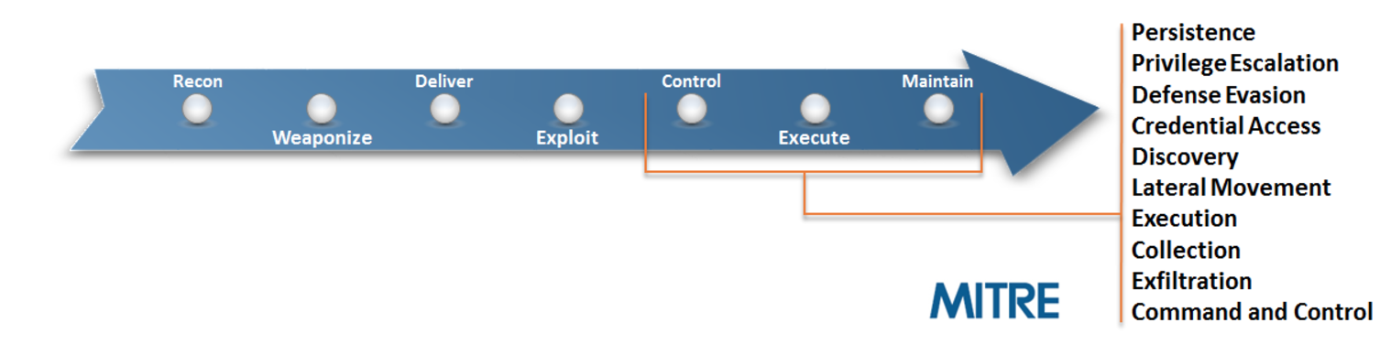
Cyber Kill Chain & MITRE ATT&CK
Cyber Kill Chain
Reveals overall the stages of a cyberattack.
Adversarial Tactics, Techniques, and Common Knowledge (ATT&CK™)
Adversary behavior model after Exploit.

Slide 4
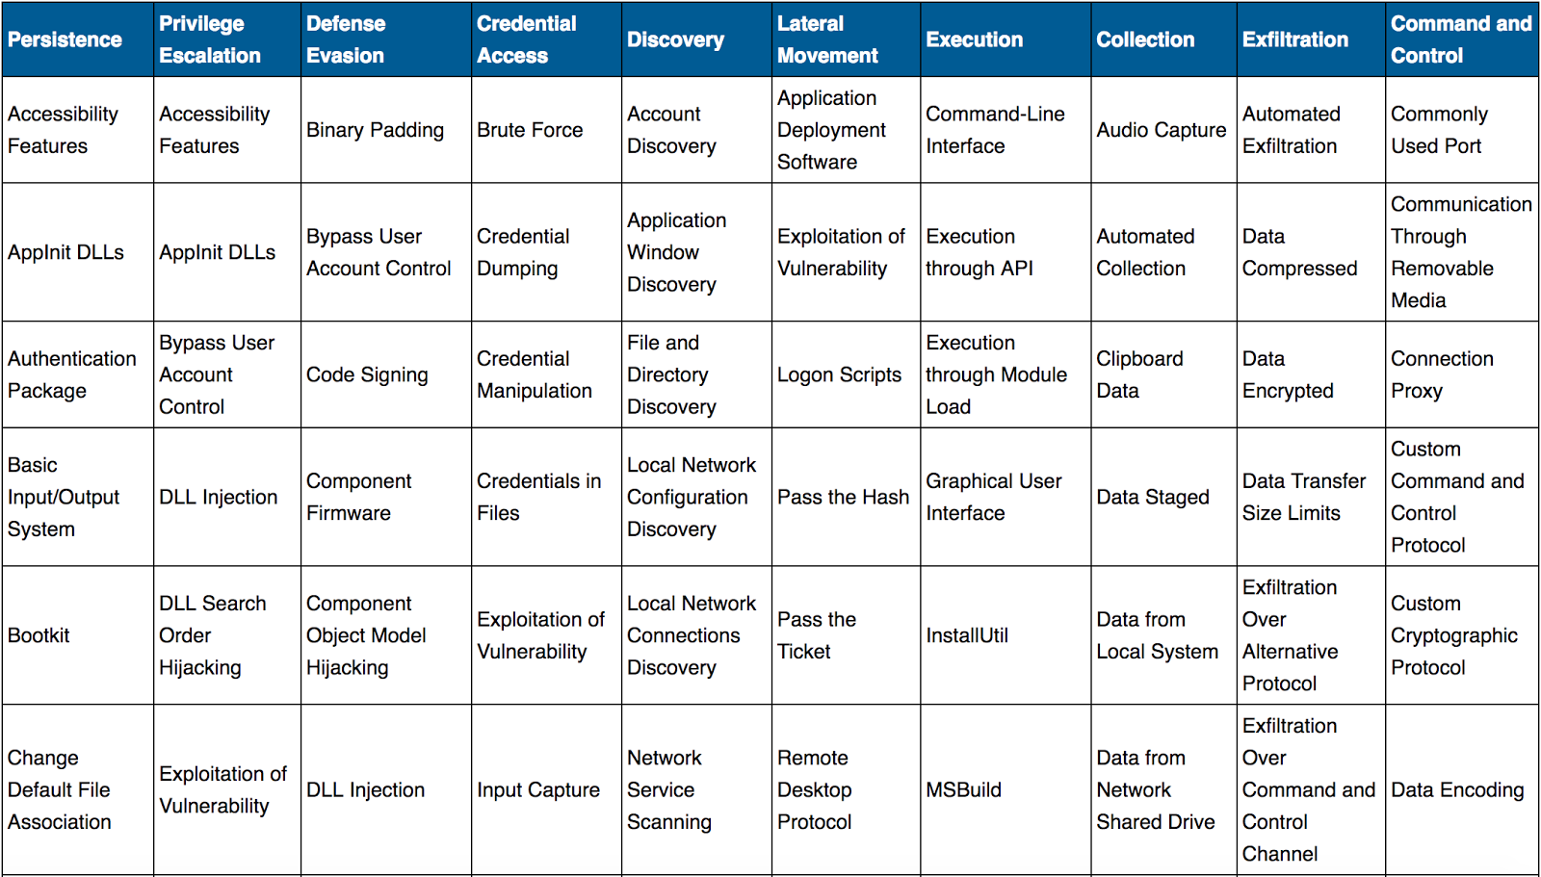
MITRE ATT&CK Matrix
Techniques
Cyber Attack techniques used by the adversary.
Tactics
Stages in the ATT&CK chain the Techniques fall into.

Slide 5
MITRE Cyber Analytics Repository(CAR)
Analytics
The CAR is a knowledge base of analytics based on ATT&CK adversary model.
CAR-2013-02-003: Processes Spawning cmd.exe
Technique: Command-Line Interface
Tactic: Execution
Typically, when a user runs a command prompt, the parent process is explorer.exe or another instance of the prompt. There may be automated programs, logon scripts, or administrative tools that launch instances of the command prompt in order to run scripts or other built-in commands. Spawning the process cmd.exe from certain parents may be more indicative of malice.
For example, if Adobe Reader or Outlook launches a command shell, this may suggest that a malicious document has been loaded and should be investigated. Thus, by looking for abnormal parent processes of cmd.exe, it may be possible to detect adversaries.
Cyber Analytics Repository
ATT&CK
Techniques
ATT&CK
Tactics

Slide 6
Sherlock
Purpose
Detect possible indicators of attack techniques from event logs.
Categorize events into stages of attack.
Visualize if a chain of attack behaviors.
Enable the user to see patterns and make the connections.
Decrease Advanced Persistent Threat detection time.
Purpose is NOT
To replace an anti-virus tool.

Slide 7

Sherlock Design
Windows Machine
Winlogbeat
Sherlock
Windows Machine
Winlogbeat
Logstash
Elasticsearch
Kibana
Windows Machine
Winlogbeat

Slide 8
Design (Collection)
Windows Machine
Winlogbeat
Sherlock
Windows Machine
Winlogbeat
Logstash
Elasticsearch
Kibana
Windows Machine
Winlogbeat

Slide 9
Design (Storage and Analysis)
Windows Machine
Winlogbeat
Sherlock
Windows Machine
Winlogbeat
Logstash
Elasticsearch
Kibana
Windows Machine
Winlogbeat

Slide 10
Design (Visualization)
Windows Machine
Winlogbeat
Sherlock
Windows Machine
Winlogbeat
Logstash
Elasticsearch
Kibana
Windows Machine
Winlogbeat

Slide 11
Collection
Process Events Logs
Network Events Logs
Sysmon
Winlogbeat
Logstash
System Event Logs
Security Event Logs
Application Event Logs
Windows Event Logs

Slide 12
Storage and Analysis
Collect time-slice of logs
Store
Elasticsearch
Elasticsearch
Sherlock
Sherlock
Perform live monitoring and analysis.
Collect time-slices of logs.
Perform analysis based on Cyber Analytics Repository using Spark.
Classify the logs to appropriate ATT&CK Tactics and Techniques.
Store back in Elasticsearch.

Slide 13
Storage and Analysis
List of Analytic Code Implemented
CAR Index | Description
CAR-2013-02-003 | Processes Spawning cmd.exe
CAR-2013-03-001 | Reg.exe called from Command Shell
CAR-2013-05-002 | Suspicious Run Locations
CAR-2013-05-003 | SMB Write Request
CAR-2013-05-004 | Execution with AT
CAR-2013-07-002 | RDP Connection Detection
CAR-2013-07-005 | Command Line Usage of Archiving Software
CAR-2013-08-001 | Execution with schtasks
CAR-2014-03-006 | RunDLL32.exe monitoring
CAR-2014-04-003 | Powershell Execution
CAR-2014-05-001 | RPC Activity
CAR-2014-05-002 | Services launching Cmd
CAR-2014-07-001 | Service Search Path Interception
CAR-2014-11-003 | Debuggers for Accessibility Applications
CAR-2014-11-004 | Remote PowerShell Sessions
CAR-2014-11-006 | Windows Remote Management (WinRM)
CAR-2014-11-008 | Command Launched from WinLogon
CAR-2016-03-001 | Host Discovery Commands
CAR-2016-03-002 | Create Remote Process via WMIC
CAR-2016-04-002 | User Activity from Clearing Event Logs
CAR-2016-04-003 | User Activity from Stopping Windows Defensive Services
CAR-2016-04-004 | Successful Local Account Login
CAR-2016-04-005 | Remote Desktop Logon

Slide 14
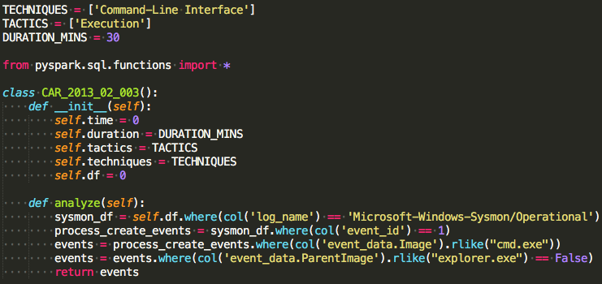
Storage and Analysis
Sample Analytic Code

Slide 15
Visualization

Slide 16
Visualization(Tactics and Techniques)

Slide 17
Visualization(Timeseries)

Slide 18
Visualization(Monitored Systems)

Slide 19
Visualization(Logs)

Slide 20
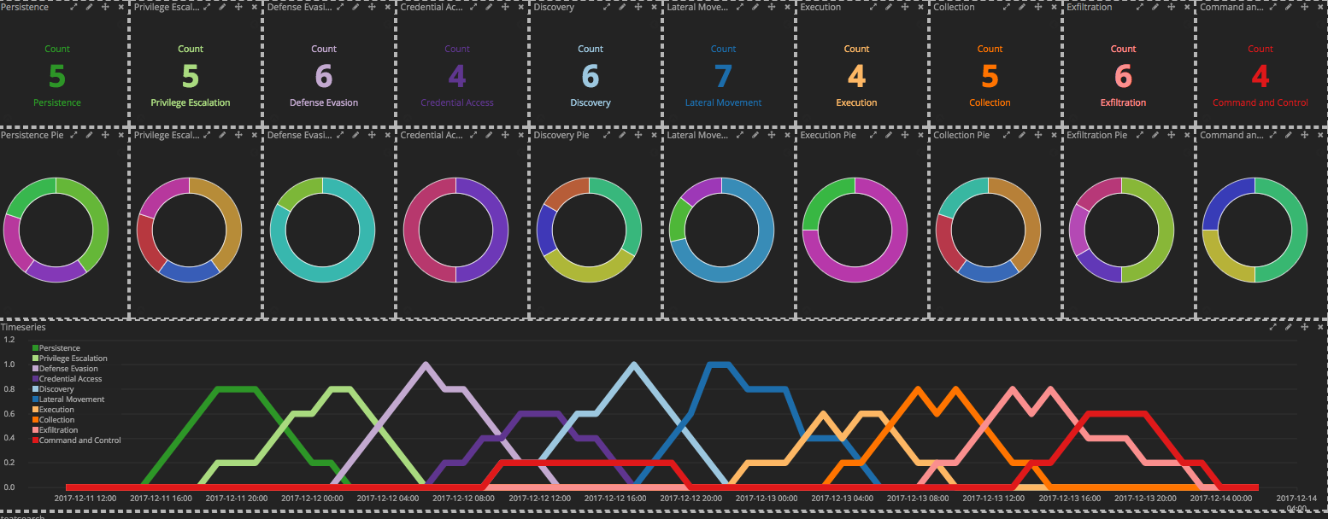
Likely Presence of APT

Slide 21
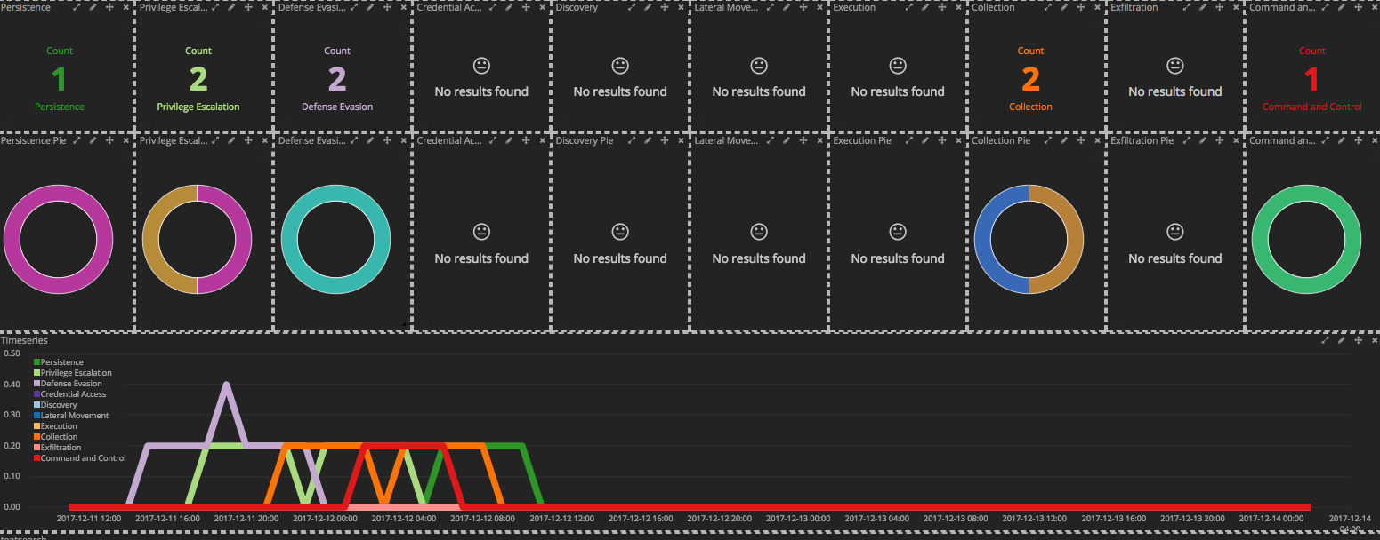
Unlikely Presence of APT

Slide 22
Conclusion
Sherlock could be a valuable tool in detecting the presence of APTs.
Visualizations are significantly more effective than going through log text.
It scales very well.
It can enable even novice Cyber Security Analysts make expert level analysis.
Future Work
Enhance with machine-learning.
Enhance to include MITRE’s private Cyber Analytic Repository.
Request open-source support.

Slide 23
Q&A?

